Slide 1
Senior Design Presentation

Slide 2
Project Contacts
Members
Gabriel Imes imesgw@mail.uc.edu
Travis Hurst hurstts@mail.uc.edu
Simon Feist feistsp@mail.uc.edu
Faculty Advisor
TBD

Slide 3
Project Charter
Project Purposes
Goals

Slide 4
Project Abstract
Our project is a Euchre game web application designed to enhance the user gameplay with data-driven insights based on historical probabilities and current gameplay information. The web app has a user-friendly interface that allows players of all skillsets to utilize the data provided to make an informed decision. Using data analysis techniques, the program continuously analyzes card distribution and player actions to recommend optimal moves before the user plays a card. This application also features an AI-powered bot that plays against and with the user playing the best move available. This application aims to improve both the user's strategic understanding of Euchre and their winning potential through data-focused guidance.

Slide 5
User Stories
As a new user, I want to easily navigate the interface and understand the information and data being shown.
As a casual Euchre player, I want to play against an AI bot so that I can improve my euchre skills based on the probabilities provided.
As an advanced Euchre player, I want to view the probability of winning after each card is played so I can make more informed decisions during the game.
As a data scientist, I want to see a detailed and accurate statistical analysis after each played card so I can better understand where our model is strong and where it needs help.

Slide 6
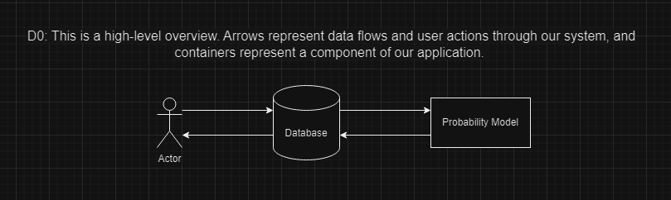
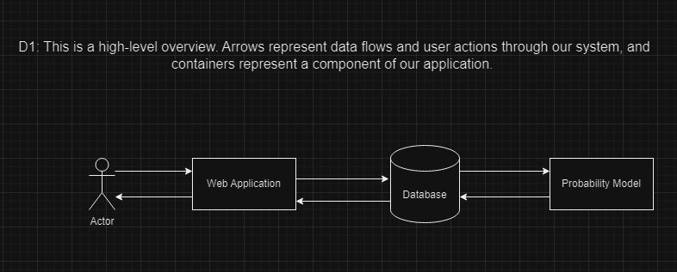
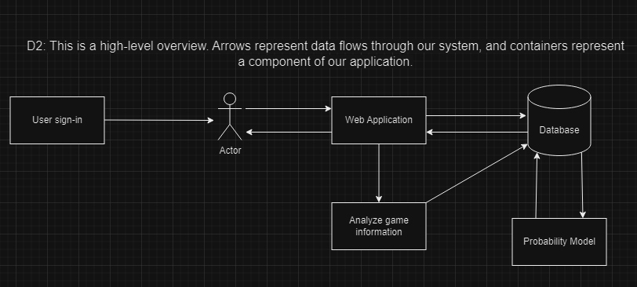
Design Diagrams

Slide 7
Project Constraints
Ethical Concerns | Legal Concerns | Security Concerns
Focus on educating users on Euchre rules, avoiding gambling or betting. | Ensures no use of patented or proprietary technology. | Protects user data with encrypted passwords and secure authentication.
Game remains free and avoids user manipulation for financial gain. | Avoids accidental infringement by designing independent probability calculations and data structures. | Informs users about data usage, complying with relevant data protection laws.

Slide 8
Current Project Progress

Slide 9
Expected Semester Accomplishments
Semester/End-of-the-Year Goals | End Date
Research for all components is completed | 10/24/2024
Design specifications are completed, and development has been started | 10/31/2024
Initial development is complete and Initial euchre game is in a working state | 1/12/2024

Slide 10
Division of Work
Task List | Assignee
Specify and design system architecture
Specify and design data model
Research and document database software and data storage
Research and document application and user interface framework
Research and document AI/Automated bot integration
Design database software and data storage tables
Design and specify application user actions
Design and specify admin view of application
Develop application user interface(euchre game only)
Develop database and data storage tables
Develop probability calculations from database tables
Develop admin view for application with views of relevant data
Develop AI/automated bot for initial euchre game
Validate working model for initial euchre game
Validate correct data transferred to database
Validate correct data returned from database to user interface
Validate correctness of AI / automated bot actions for initial euchre game
Develop overlay for probability calculations
Refine AI/automated bot actions to increase probablility outcomes
Refine user interface to include additional features
Refine admin view to give more value to data

Slide 11
Expected Demo
Make eye contact with your audience to create a sense of intimacy and involvement
Weave relatable stories into your presentation using narratives that make your message memorable and impactful
Encourage questions and provide thoughtful responses to enhance audience participation
Use live polls or surveys to gather audience opinions, promoting engagement and making sure the audience feel involved

Slide 12
Thank you
Brita Tamm
502-555-0152
brita@firstupconsultants.com
www.firstupconsultants.com

